Slide 1
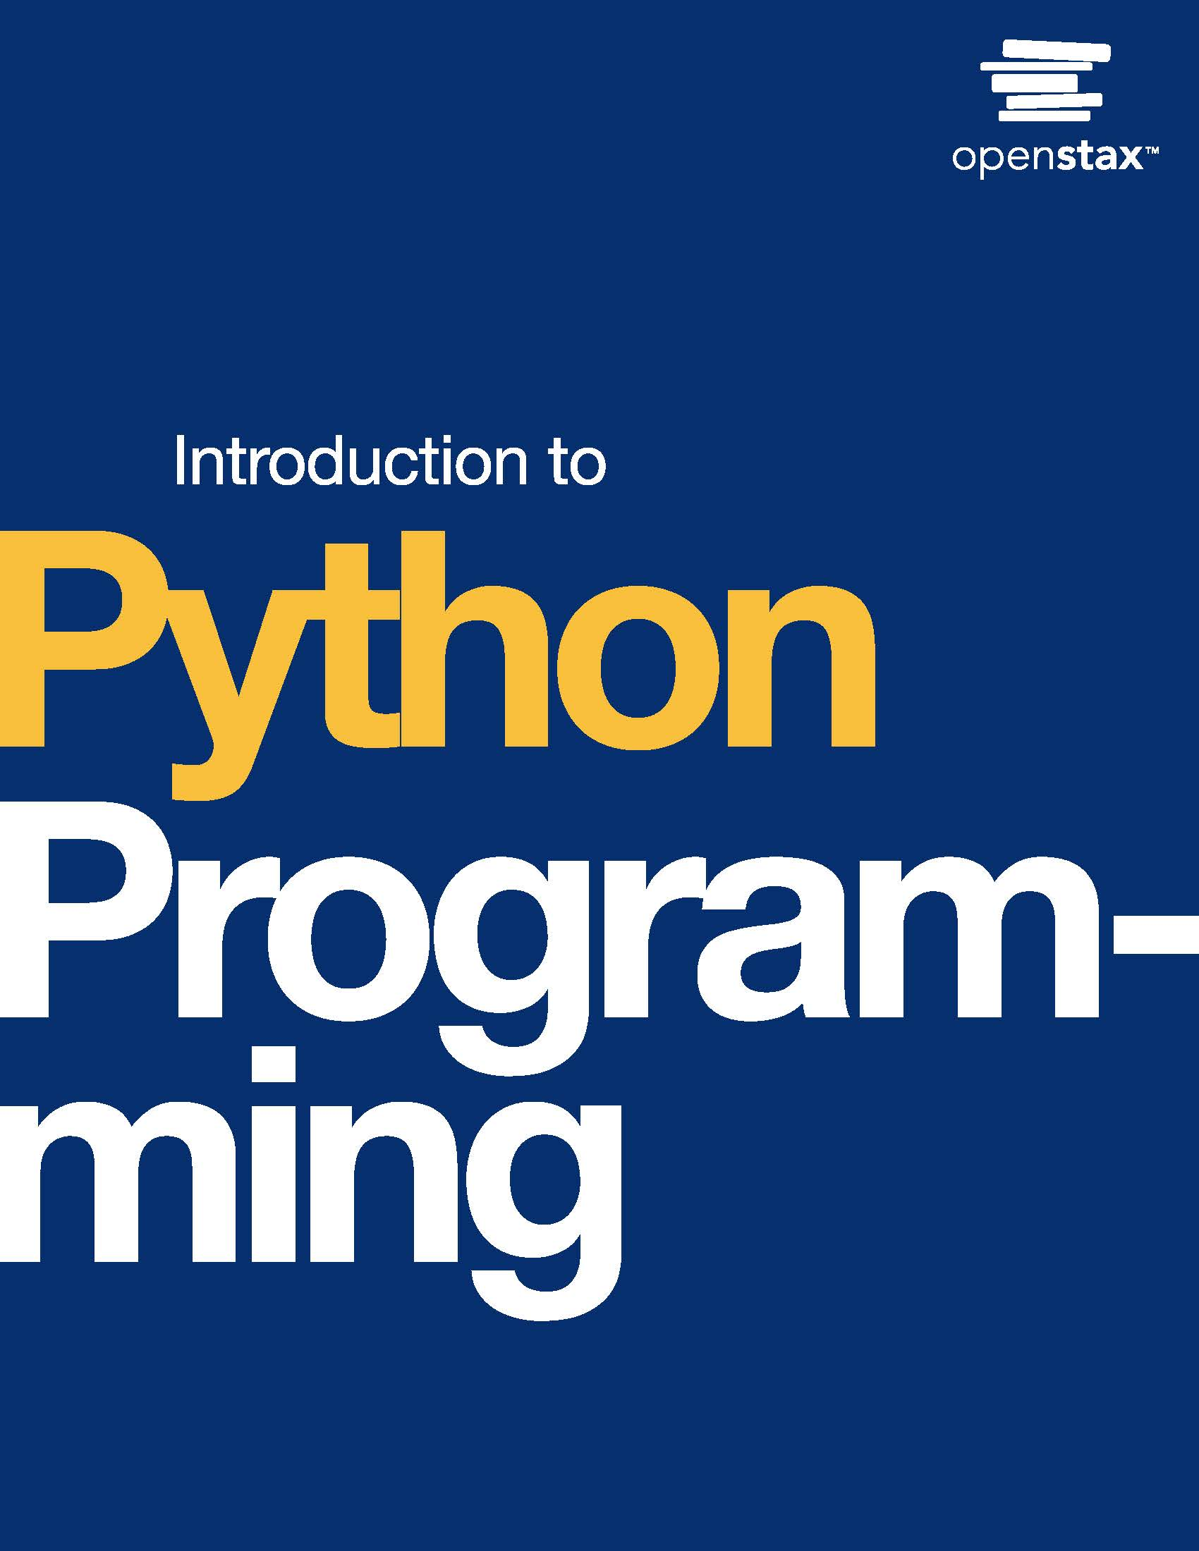
Introduction to Python Programming
Chapter 5: Loops

Slide 2
Chapter outline
While loop
For loop
Nested loops
Break and continue
Loop else

Slide 3

Figure 5.1
credit: modification of work "Quantum Computing", by Kevin Dooley/Flickr, CC BY 2.0
Notes:
an image of a fractal

Slide 4
5.1 While loop
Learning Objectives
Explain the loop construct in Python.
Use a while loop to implement repeating tasks.

Slide 5
5.1 While loop
A while loop is a code construct that runs a set of statements, known as the loop body, while a given condition, known as the loop expression, is true.
At each iteration, once the loop statement is executed, the loop expression is evaluated again.
If true, the loop body will execute at least one more time (also called looping or iterating one more time).
If false, the loop's execution will terminate and the next statement after the loop body will execute.

Slide 6
5.1 While loop
Counting with a while loop
A while loop can be used to count up or down.
A counter variable can be used in the loop expression to determine the number of iterations executed.
Ex: A programmer may want to print all even numbers between 1 and 20.
The task can be done by using a counter initialized with 1.
In each iteration, the counter's value is increased by one, and a condition can check whether the counter's value is an even number or not.
The change in the counter's value in each iteration is called the step size.
The step size can be any positive or negative value. If the step size is a positive number, the counter counts in ascending order, and if the step size is a negative number, the counter counts in descending order.

Slide 7
5.2 For loop
Learning Objectives
Explain the for loop construct.
Use a for loop to implement repeating tasks.

Slide 8
5.2 For loop
A container can be a range of numbers, a string of characters, or a list of values.
To access objects within a container, an iterative loop can be designed to retrieve objects one at a time.
A for loop iterates over all elements in a container.
Ex: Iterating over a class roster and printing students' names.

Slide 9
5.2 For loop
A range() function generates a sequence of integers between the two numbers given a step size.
This integer sequence is inclusive of the start and exclusive of the end of the sequence.
The range() function can take up to three input values. Examples are provided in the table below.

Slide 10
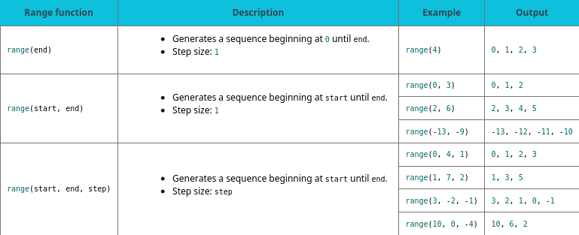
Table 5.1 Using the range() function.

Slide 11
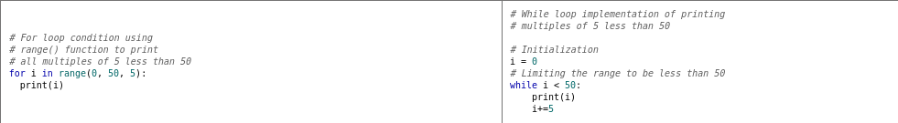
Table 5.2

Slide 12
5.3 Nested loops
Learning Objectives
Implement nested while loops.
Implement nested for loops.

Slide 13
5.3 Nested loops
A nested loop has one or more loops within the body of another loop.
The two loops are referred to as outer loop and inner loop.
The outer loop controls the number of the inner loop's full execution.
More than one inner loop can exist in a nested loop.

Slide 14
5.3 Nested loops
A nested for loop can be implemented and used in the same way as a nested while loop.
A for loop is a preferable option in cases where a loop is used for counting purposes using a range() function, or when iterating over a container object, including nested situations.
Ex: ​​Iterating over multiple course rosters.
The outer loop iterates over different courses, and the inner loop iterates over the names in each course roster.

Slide 15
5.4 Break and continue
Learning Objectives
Analyze a loop's execution with break and continue statements.
Use break and continue control statements in while and for loops.

Slide 16
5.4 Break and continue
A break statement is used within a for or a while loop to allow the program execution to exit the loop once a given condition is triggered.
A break statement can be used to improve runtime efficiency when further loop execution is not required.

Slide 17
5.4 Break and continue
Infinite loop
A break statement is an essential part of a loop that does not have a termination condition.
A loop without a termination condition is known as an infinite loop.
Ex: An infinite loop that counts up starting from 1 and prints the counter's value while the counter's value is less than 10.
A break condition is triggered when the counter's value is equal to 10, and hence the program execution exits.

Slide 18
5.5 Loop else
Learning Objectives
Use loop else statement to identify when the loop execution is interrupted using a break statement.
Implement a loop else statement with a for or a while loop.

Slide 19
5.5 Loop else
A loop else statement runs after the loop's execution is completed without being interrupted by a break statement.
A loop else is used to identify if the loop is terminated normally or the execution is interrupted by a break statement.

Slide 20
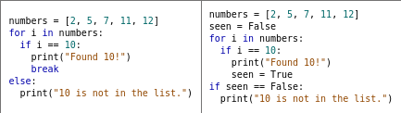
Example 5.4, Table 5.3
Finding the number 10 in a list
In the code examples below, the code on the left prints "Found 10!" if the variable i's value is 10.
If the value 10 is not in the list, the code prints "10 is not in the list.".
The code on the right uses the seen Boolean variable to track if the value 10 is in the list. After loop's execution, if seen's value is still false, the code prints "10 is not in the list.".

Slide 21
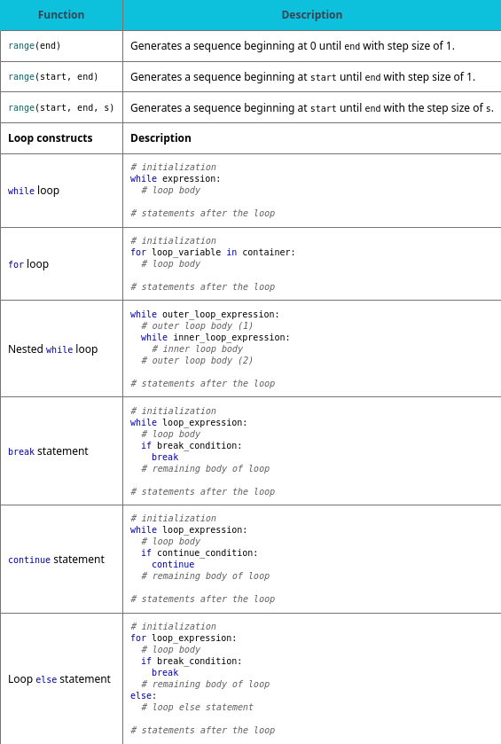
Table 5.4 Chapter 5 reference.

Slide 22
This ancillary resource is licensed under a Creative Commons Attribution-NonCommercial-ShareAlike 4.0 (CC BY NC-SA) license; it may be distributed, remixed, built upon for noncommercial purposes only, and must be attributed to OpenStax and redistributed under the same license.

